Slide 1


Chapter 7: IUS for detecting complications of IBD
v1.0, 10 December 2022 | EM-121011
For Healthcare Professionals only
Developed under the mentorship of the Asian Organization for Crohn's & Colitis
Supported by Janssen Asia Pacific, a division of Johnson and Johnson International (Singapore) Pte. Ltd. Editorial development by Transform Medical Communications, New Zealand
© Janssen Asia Pacific, a division of Johnson & Johnson International (Singapore) Pte. Ltd.

Slide 2
About IUS Primer module
IUS Primer module was created for training gastroenterologists in Asia on adopting Intestinal Ultrasound (IUS) for the diagnosis and management of Inflammatory Bowel Disease
Transform Medical Communications was commissioned by Janssen Asia Pacific for the development of this educational module under the guidance of IUS Primer working group members and AOCC. The division of Janssen responsible for developing the module is from medical education that follows strict non-promotional and educational guidance.
The development of the module was funded by Janssen Asia Pacific, a division of Johnson and Johnson International (Singapore) Pte. Ltd. in 2022. Non-commercial use of this module is permitted without any further permission, provided credit for the content is clearly attributed to Janssen Asia Pacific.
AOCC: Asian Organization for Crohn's & Colitis; IUS: Intestinal ultrasound.

Slide 3

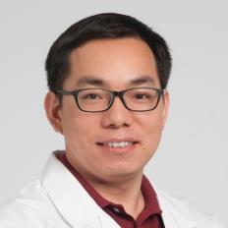
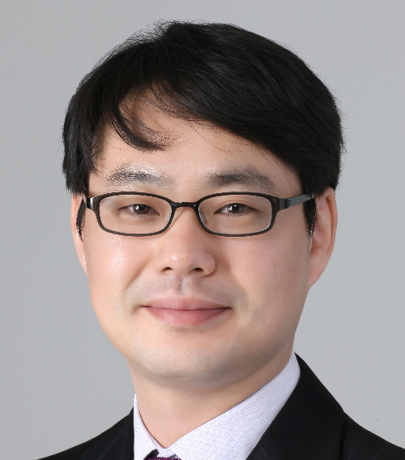

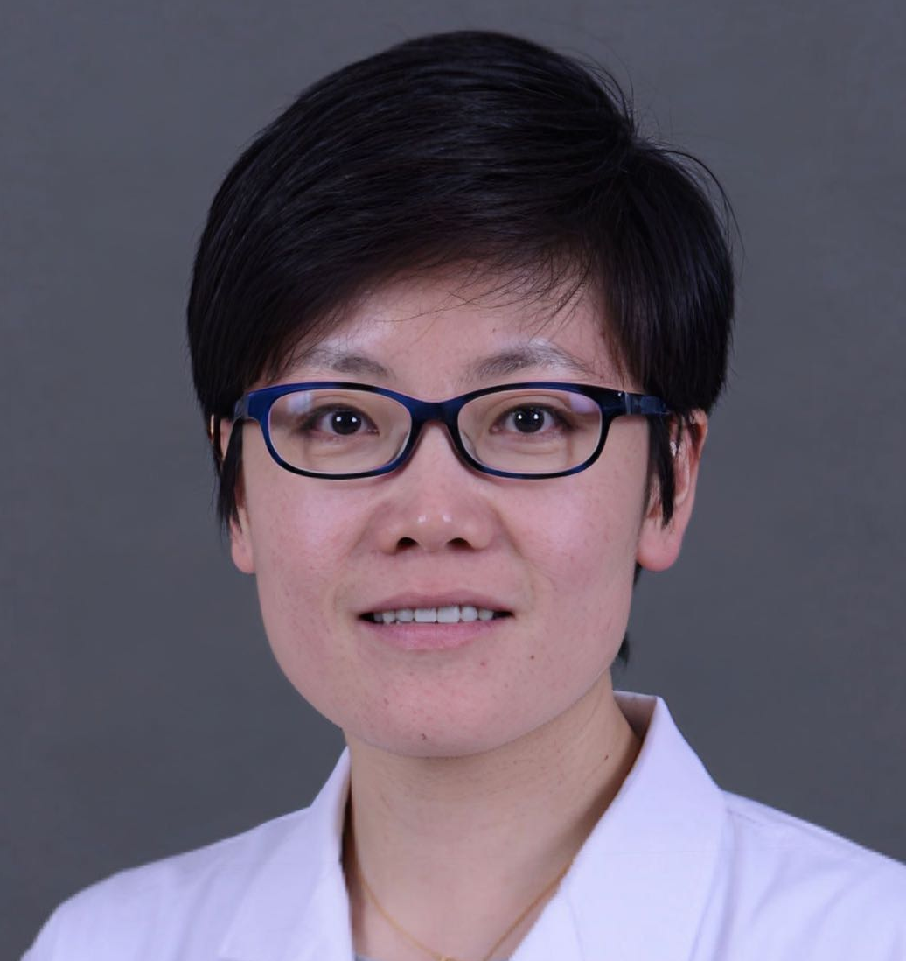


Special thanks to IUS Primer AOCC working group members
Prof. Eun Soo KIM
A/Prof. Ren MAO
Kyungpook National University
First Affiliated Hospital of Sun Yat-sen University
KOREA
CHINA
Prof. Chang Kyun LEE
A/Prof. Jun MIYOSHI
Kyung Hee University
Kyorin University
KOREA
JAPAN
Prof. Yue LI
Dr. Shintaro SAGAMI
Peking Union Medical College Hospital
Kitasato University Kitasato Institute Hospital
CHINA
JAPAN
AOCC: Asian Organization for Crohn's & Colitis; IUS: Intestinal ultrasound; WG: working group.

Slide 4
Learning Objectives
Learn the role of IUS for detecting complications in IBD, e.g., bowel obstruction, fistula, abscess, stenosis
Explore the sensitivity and specificity of IUS for detecting these complications
Understand the recommendations from international guidelines on utility of IUS in managing IBD in an emergency setting
1
2
3
IBD: inflammatory bowel disease; IUS: Intestinal ultrasound; WG: working group

Slide 5
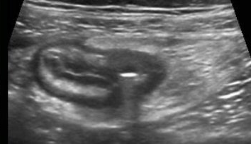
Complications of IBD: Ulceration
Ulcers are depressions in the mucosal layer, seen as strong hyperechoic eccentric foci within hypoechoic areas.^{1,2}
Image credits Zijta, F., Vanhooymissen I & Puylaert J, Radiology Assistant website. Reproduced from Radiology Assistant website,¹ strictly for educational purposes only.
IBD: inflammatory bowel disease; IUS: Intestinal ultrasound
1. Zijta, F., Vanhooymissen, I. & Puylaert, J. Crohn's disease - role of Ultrasound. Available at: https://radiologyassistant.nl/abdomen/bowel/ultrasound-in-crohns-disease. 2. Jauregui-Amezaga, A., & Rimola, J. (2021). Life (Basel, Switzerland), 11(7), 603.

Slide 6
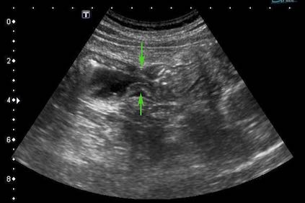
Complications of IBD: Strictures (fibrotic stenosis)
*
Strictures are wall thickening with a narrowed lumen (arrows), with or without dilatation (*) of the proximal loop (pre-stenotic dilatation).²
Image credits Zijta, F., Vanhooymissen I & Puylaert J, Radiology Assistant website.¹ Reproduced from Radiology Assistant website,¹ strictly for educational purposes only.
IBD: inflammatory bowel disease; IUS: Intestinal ultrasound
1. Zijta, F., Vanhooymissen, I. & Puylaert, J. Crohn's disease - role of Ultrasound. Available at: https://radiologyassistant.nl/abdomen/bowel/ultrasound-in-crohns-disease. 2. Jauregui-Amezaga, A., & Rimola, J. (2021). Life (Basel, Switzerland), 11(7), 603.

Slide 7
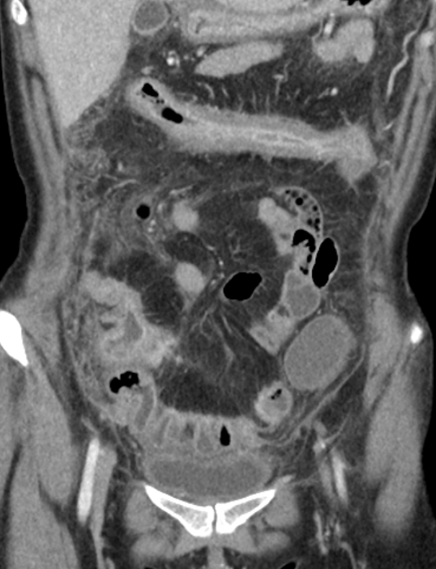
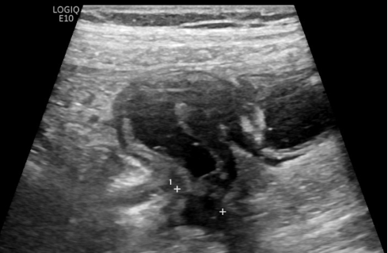
Comparing CT and IUS findings stricture in CD
Stricture (shown with yellow arrows) in a patient with CD on CT (left) and IUS (right)
Photo kindly provided by Prof. Chang Kyun Lee, Kyung Hee University, Korea
Photo kindly provided by Prof. Chang Kyun Lee, Kyung Hee University, Korea
IUS: Intestinal ultrasound; BWS: BWS: bowel wall stratification; CD: Crohn’s disease.

Slide 8
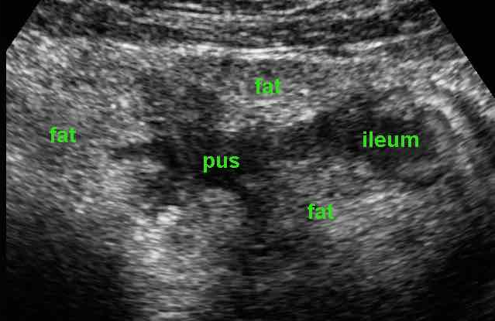
Complications of IBD: Abscess
Abscesses are seen as hypo-anechoic lesions containing fluid and gaseous artefacts, posterior enhancement, irregular margins sometimes within hypertrophic mesentery (without vascular signals at colour doppler).²
Image credits Zijta, F., Vanhooymissen I & Puylaert J, Radiology Assistant website^{.1} Reproduced from Radiology Assistant website,¹ strictly for educational purposes only.
IBD: inflammatory bowel disease; IUS: Intestinal ultrasound
1. Zijta, F., Vanhooymissen, I. & Puylaert, J. Crohn's disease - role of Ultrasound. Available at: https://radiologyassistant.nl/abdomen/bowel/ultrasound-in-crohns-disease. 2. Jauregui-Amezaga, A., & Rimola, J. (2021). Life (Basel, Switzerland), 11(7), 603.

Slide 9
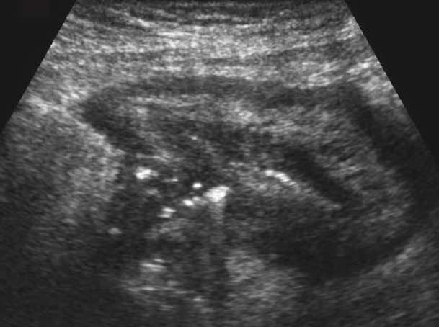
Complications of IBD: Sinus tract
Air configurations reaching beyond the peripheral borders of the bowel wall indicate the formation of a sinus tract.^{1,2}
Image credits Zijta, F., Vanhooymissen I & Puylaert J, Radiology Assistant website¹ Reproduced from Radiology Assistant website,¹ strictly for educational purposes only.
IBD: inflammatory bowel disease
1. Zijta, F., Vanhooymissen, I. & Puylaert, J. Crohn's disease - role of Ultrasound. Available at: https://radiologyassistant.nl/abdomen/bowel/ultrasound-in-crohns-disease. 2. Jauregui-Amezaga, A., & Rimola, J. (2021). Life (Basel, Switzerland), 11(7), 603.
Notes:
Ref- JA

Slide 10
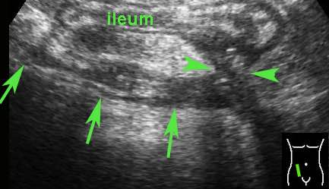
Complications of IBD: Fistula
Fistula is seen as a hypoechoic peri-intestinal area with a diameter <2cm with or without internal gaseous artefacts. ^{1,2}
Image credits Zijta, F., Vanhooymissen I & Puylaert J, Radiology Assistant website¹ Reproduced from Radiology Assistant website,¹ strictly for educational purposes only.
IBD: inflammatory bowel disease
1. Zijta, F., Vanhooymissen, I. & Puylaert, J. Crohn's disease - role of Ultrasound. Available at: https://radiologyassistant.nl/abdomen/bowel/ultrasound-in-crohns-disease. 2. Jauregui-Amezaga, A., & Rimola, J. (2021). Life (Basel, Switzerland), 11(7), 603.
Notes:
Ref- JA

Slide 11
Complications of IBD: small bowel obstruction
*
A small bowel obstruction is seen as fluid-filled, dilated SB loops (*) with hyper-kinesis and hyper-representation of valvulae conniventes.
A dilated small bowel loop with a calibre of more than 3 cm (dotted line shown by the green arrow) with trapped faeces defines a ‘small bowel faeces sign’.^{1,2} Bowel walls appear thin, and the folds flatten.²
Image reproduced from Rosano, N., et al. (2021). Diagnostics, 11(4), 617. (Attribution 4.0 International (CC BY 4.0). https://creativecommons.org/licenses/by/4.0/legalcode
IBD: inflammatory bowel disease
1. Tewari, A., Weiden, J., & Johnson, J. O. (2013). Emergency radiology, 20(4), 341-344. 2. Rosano, N., et al. (2021). Diagnostics, 11(4), 617.
Notes:
Ref- JA

Slide 12
Cross-sectional imaging surpasses endoscopy in detecting and differentiating stenosis¹⁻³
Sonographic assessment of the echo pattern of the bowel wall can discriminate between fibrotic and inflammatory strictures more accurately than biomarkers of inflammatory activity.²
Identification of underlying pathology is important for the management of stenosis.^{1,2}
 | Inflammatory | Fibrotic
IUS echo-pattern² | Loss of stratification of the bowel wall at the level of the stricture | Presence of stratification
Management¹ | Medical therapy | Surgical treatment
Advantage of IUS over CT/MRI: Real-time dynamic display of excess peristalsis with IUS reflects the degree of blockage.³
  The sensitivity of IUS is comparable to MRI in detecting strictures in IBD.⁴
IUS: Intestinal ultrasound. MRI: magnetic resonance imaging; CT: computed tomography
1. Fraquelli, M., Castiglione, F., Calabrese, E., & Maconi, G. (2020). Digestive and Liver Disease, 52(1), 9-18. 2. Calabrese, E., et al. (2016). Inflammatory bowel diseases, 22(5), 1168-1183. 3. Rimola, J., & Capozzi, N. (2020). Intestinal research, 18(2), 144. 4. Clough J (2021) Intestinal ultrasound assessment in IBD: another string to the gastroenterologist’s bow? Available at: https://blogs.bmj.com/fg/2021/11/01/intestinal-ultrasound-assessment-in-ibd-another-string-to-the-gastroenterologists-bow/
Notes:
1. Fraquelli, M., Castiglione, F., Calabrese, E., & Maconi, G. (2020). Digestive and Liver Disease, 52(1), 9-18.
2. Calabrese, E., et al. (2016). Inflammatory bowel diseases, 22(5), 1168-1183.
3. Rimola, J., & Capozzi, N. (2020). Intestinal research, 18(2), 144.
4. Clough J (2021) Intestinal ultrasound assessment in IBD: another string to the gastroenterologist’s bow? Available at: https://blogs.bmj.com/fg/2021/11/01/intestinal-ultrasound-assessment-in-ibd-another-string-to-the-gastroenterologists-bow/

Slide 13
Sensitivity and specificity of IUS for diagnosing penetrating complications in IBD
Colonoscopy and X-ray are unable to show transmural inflammation and extraluminal complications.^{1,2}
Cross-sectional imaging has high accuracy for the detection of penetrating complications such as fistulae/ abscesses in CD.^{1,2}
Detection of fistulae | IUS vs MRI/ CT scan¹ | IUS vs X rays³ | IUS + X ray³
Sensitivity | IUS: 74%; CT: 70%; MRI:76% | IUS: 71.4% X-ray: 69.6% | 97.4%
Specificity | IUS: 95%; CT: 97%; MRI: 96% | IUS: 95.8% X-ray: 95.8% | 90%
Detection of abscess | IUS vs MRI/ CT scan¹
Sensitivity | IUS: 84%; CT: 84%; MRI: 86%
Specificity | IUS: 93%; CT: 97%; MRI: 93%
IUS or MRI are preferred due to the lack of radiation exposure.¹ Combination of IUS with X-ray can improve diagnostic accuracy.¹
CD: Crohn’s disease; IBD: inflammatory bowel disease; IUS: Intestinal ultrasound. MRI: magnetic resonance imaging; CT: computed tomography
1. Panes, J., et al. (2011). Alimentary pharmacology & therapeutics, 34(2), 125-145. 2. Jauregui-Amezaga, A., & Rimola, J. (2021). Life (Basel, Switzerland), 11(7), 603. 3. Fraquelli, M., et al. (2020). Digestive and Liver Disease, 52(1), 9-18
Notes:
Panes, J., et al. (2011). Alimentary pharmacology & therapeutics, 34(2), 125-145.
Jauregui-Amezaga, A., & Rimola, J. (2021). Life (Basel, Switzerland), 11(7), 603
Fraquelli, M., et al. (2020). Digestive and Liver Disease, 52(1), 9-18
IUS more accurate for enteromesentric fistula; X ray better for entero-enteric fistula.³

Slide 14


Guidelines for managing patients presenting with acute complications of IBD
Recommendations from the World Society of Emergency Surgery - American Association for the Surgery of Trauma (WSES-AAST) guidelines
Point of care ultrasonography (POCUS) in
emergency settings
General recommendations
Point of care
Detection of endoscopically active IBD with POCUS:
Definition of extent of disease with POCUS:
Cross-sectional imaging (CT/MRI/US) is recommended
to detect strictures and extra-luminal IBD complications including fistulae and abscesses
Point of care IUS can have a role in showing free fluid, abscesses, or intestinal distention in the emergency department, particularly when CT scan is not available
Sensitivity: 91%
Specificity: 83%
PPV: 89%
NPV: 86%
Sensitivity: 87%
Specificity: 81%
PPV: 85%
NPV: 83%
POCUS is an accurate technique in defining disease activity and extent in IBD compared to ileocolonoscopy, with the advantage of being non-invasive.
CT: computed tomography; IBD: inflammatory bowel disease; MRI: magnetic resonance imaging; US: ultrasound; POCUS: point of care ultrasonography
De Simone, B. (2021). World Journal of Emergency Surgery, 16(1):1-27

